Slide 1

DEPARTMENT OF ELECTRONICS AND TELECOMMUNICATION ENGINEERING
STES’S SINHGAD ACADEMY OF ENGINEERING
By
MIHIR INGOLE
ANANGSA BISWAS
SAMRUDDHI DIDAKE
AGNIJ DAVE
Under the guidance of
Dr. Mrs.P.S.Deshpande

Slide 2
LICENSE PLATE RECOGNITION USING DEEP LEARNING METHODS

Slide 3
CONTENTS
INTRODUCTION
MOTIVATION AND SCOPE
MAJOR CHALLENGES
LITERATURE REVIEW
SYSTEM ARCHITECTURE
SYSTEM FLOWCHAT
WORKING
LP DETECTION
LP EXTRACTION
OCR
RESULTS
APPLICATIONS
CONCLUSION

Slide 4
INTRODUCTION
Automatic License Plate Recognition (ALPR) helps to identify vehicle license plates in an efficient manner without the need for major human resources and has become more and more important in the recent years. The rapid development in digital image processing technology has also made it possible to detect and identify license plates at a fast rate.
This project will present an alternative approach by using deep learning to automatically recognize license plates. Deep learning techniques do not use hand-engineered features, but automatically select the features themselves. The strongest deep learning methods involve Convolution Neural Networks (CNNs).
There are various algorithms that can be used for object detection. However the Faster R-CNN family provides better accuracy Furthermore we have used Tensorflow as the deep learning library inorder to facilitate large scale neural networks.

Slide 5
MOTIVATION AND SCOPE
The main motivation of this project is to take into consideration the technological advancements of this generation and implement it for efficient management and supervising of vehicles. This system tackles the problem of mismanagement and excess time wastage incurred due to involvement of manual labor. Furthermore, it provides information about the vehicles entering an area which is valuable to the concerned authorities. This ultimately helps in cost reduction and time management along with proper supervision in various sectors as compared to the old approach.
The scope of this project is to be able to detect license plates appearing on the roads. This means that the most important part of the system is to be able to detect a license plate with high accuracy.

Slide 6
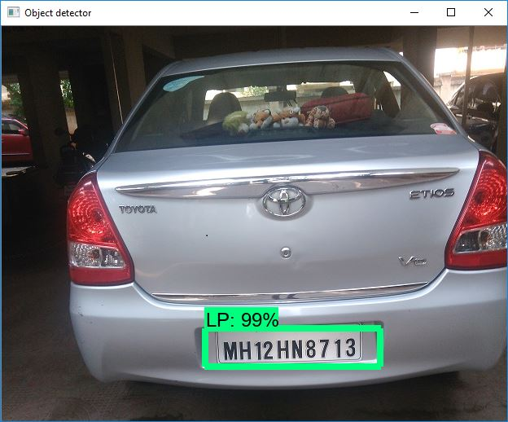
MAJOR CHALLENGES
Even though most cases will be of standard license plates, there are a number of variations causing challenges when detecting and recognizing these plates listed below.
An Ideal License Plate

Slide 7
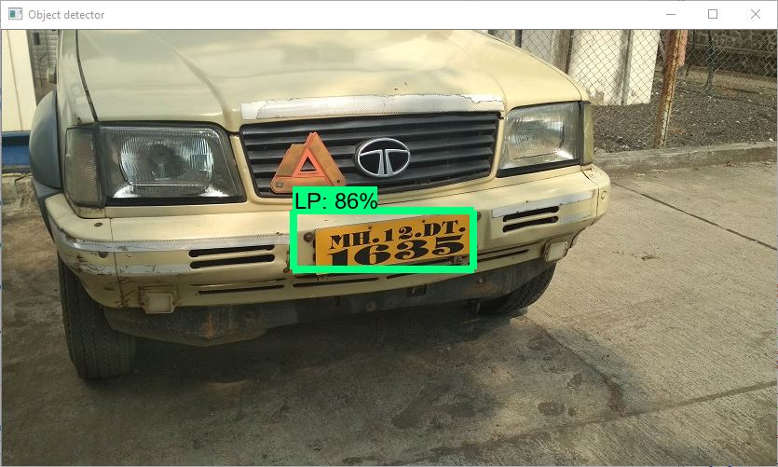
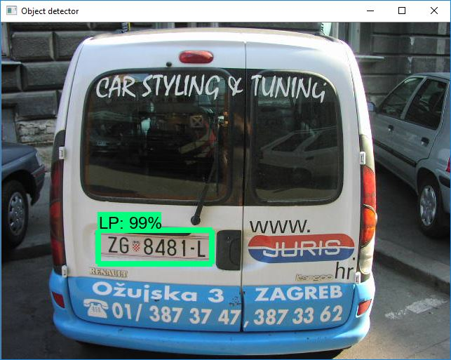
Background color: While white is most commonly used as the background color. However, there are exceptions.
Location: The plate may be located in different parts of the image.

Slide 8
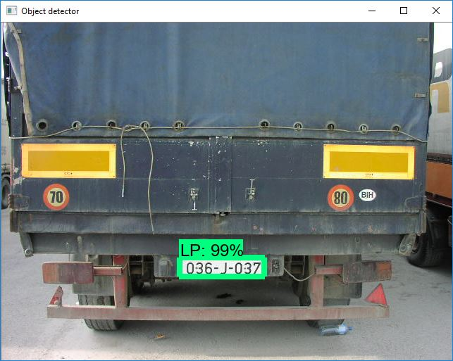
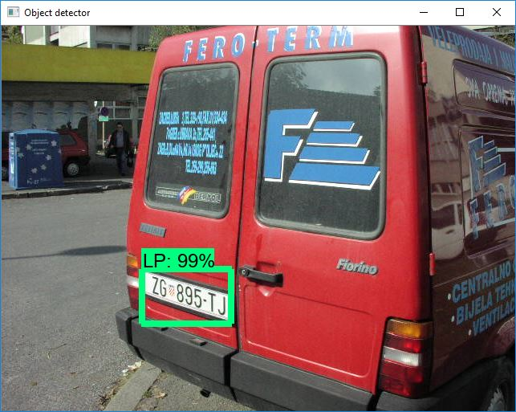
Size: The size of the plate compared to the full captured image differs based on camera distance and zooming.
Rotation: The plate may be tilted based on the angle the image is taken.

Slide 9
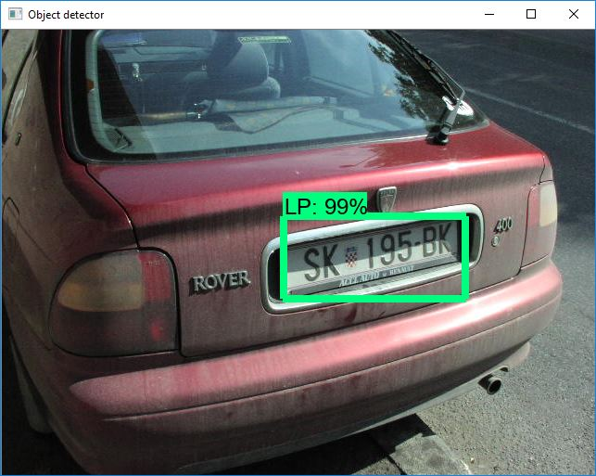
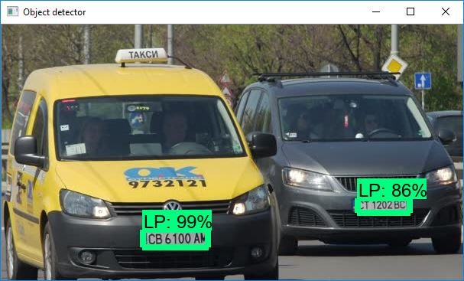
Occlusion: The plate may be obscured by additional noise, such as dirt or snow.
Quantity: An image may have captured none, one or multiple plates.

Slide 10
LITERATURE REVIEW
In Relation to Convolution Neural Networks we referred to ‘Deep Learning System for Automatic License Plate Detection and Recognition’ by Zied Selmi, Mohamed Ben Halima and Adel M. Alimi’s work presented at the 14th IAPR International Conference,2017.
In this paper the proposed method uses a deep learning architecture represented by a CNN model in LP detection and recognition.
A few steps of pre-processing have been carried out such as morphological operations, adaptive thresholding, fine contours, geometric filtering,etc.
This pre-processed image is then used in the detection process to classify between a ‘plate’ and ‘non-plate’.
They have used another CNN model for character recognition.

Slide 11
In Relation to Faster R CNN we have referred to the paper ‘Preprocessed Faster RCNN for Vehicle Detection’ by Mduduzi Manana, Chunling Tu and Pius Adewale Owolawi presented at the IEEE Conference on Intelligent and Innovative Computing Applications,2018.
This paper focuses on the algorithmic modification of Faster RCNN. A preprocessing method is integrated to faster RCNN to improve training and detection speed. The preprocessing pipeline reduces the region of interest which results in a reduced number of pixels to be processed by faster RCNN.
This improves the processing speed of the Faster RCNN. A vehicle detection method is proposed that reduces a region of interest by preprocessing an image before it is processed by faster RCNN.
The results show that preprocessing an image into a reduced rectangular portion of the original image improves training speed.

Slide 12
We also referred to Myung-Cheol Roh and Ju-young Lee’s ‘Refining Faster-RCNN for Accurate Object Detection’, from the15th IAPR International Conference on Machine Vision Applications,May2017.
Region-based convolutional network (RCNN) is one of the state art detection methods. The conventional Faster-RCNN is composed of 5 main parts: a deep fully convolutional network, region proposal network, ROI pooling and fully connected networks, bounding box regressor and classifier.
Through the deep fully convolutional and region proposal networks, a lot of object candidates are proposed and the candidate regions (proposals) are normalized through ROI Pooling layer. Then, fully connected layers extract good features to conduct classification and regression.
The proposed RF-RCNN is applied to human and license plate detection.

Slide 13
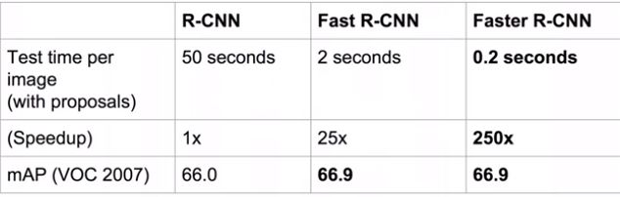
We also referred to Nikhil Yadav and Utkarsh Binay’s ‘Comparative Study of Object Detection Algorithms’ presented at the International Research Journal of Engineering and Technology (IR-JET),Nov 2017.
In this paper they compare the training and testing times, with more focus on the testing times of the different model combinations and what difference we obtain with different hyperparameter tuning.
The least accurate model was R-FCN MobileNet, whereas the most accurate model was Faster R-CNN Inception Resnet.

Slide 14
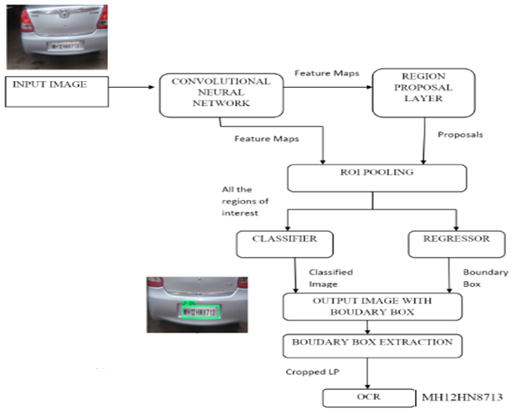


Slide 15
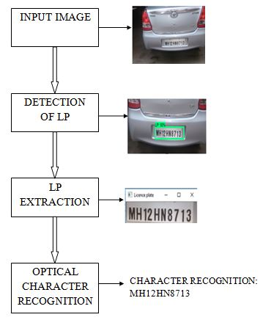
SYSTEM FLOWCHART

Slide 16
WORKING

Slide 17
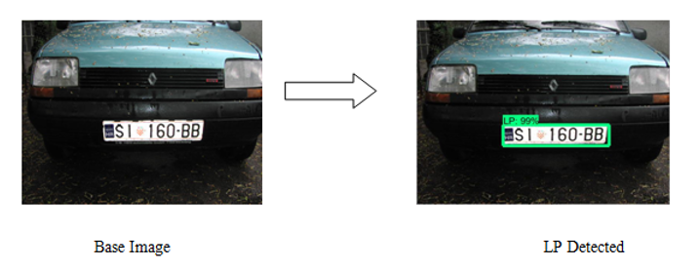
License Plate DETECTION
We have compared a few methods to see which algorithm implements the system most accurately.

Slide 18
Convolutional NEURAL NETWORK
Convolutional neural networks (CNNs) are biologically inspired neural networks .
Used in objects detections, recognition of faces etc.,
It consists of
Local receptive fields
Shared weights
Pooling

Slide 19

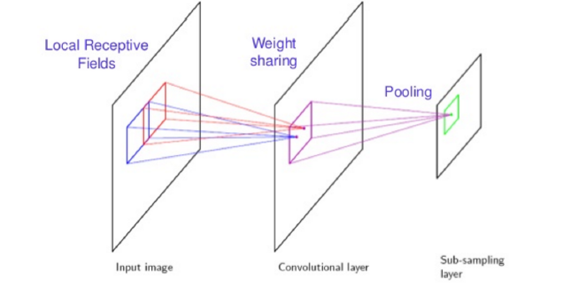

Slide 20
Convolutional NEURAL NETWORK
Limitations:
The objects in the image can have different aspect ratios and spatial locations.
The shapes of the objects might also be different sizes (happens a lot in real-life use cases).
We would require a very large number of regions resulting in a huge amount of computational time.

Slide 21
R-CNN
REGION-BASED CONVOLUTIONAL NEURAL NETWORK(R-CNN)
Object Detection Using R-CNN
We first take a pre-trained convolutional neural network.
Then this model is retrained.
The third step is to get the Region of Interest for each image.
After getting the regions, we train SVM.
Finally, we train a linear regression model.

Slide 22
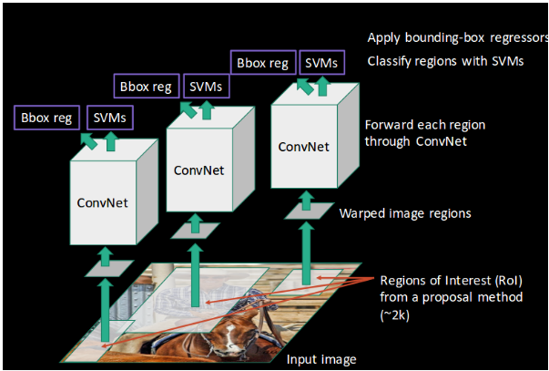
R-CNN

Slide 23
R-CNN
Limitations:
Extracting 2,000 regions for each image based on selective search.
Extracting features using CNN for every image region. Suppose we have N images, then the number of CNN features will be N*2,000.

Slide 24
FAST r-cnn
In Fast RCNN, we feed the input image to the CNN, which in turn generates the convolutional feature maps.
Using these maps, the regions of proposals are extracted.
We then use a RoI pooling layer to reshape all the proposed regions into a fixed size, so that it can be fed into a fully connected network.

Slide 25

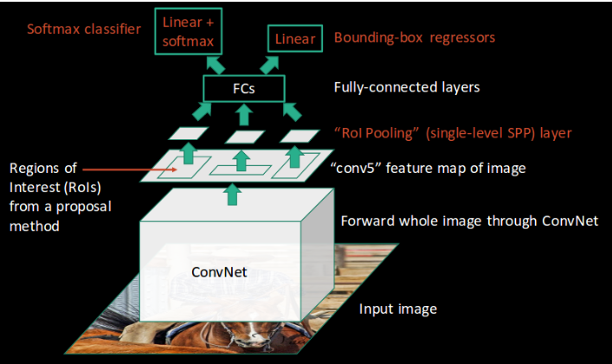

Slide 26
FAST R-CNN
Limitation:
But even Fast RCNN has certain problem areas. It also uses selective search as a proposal method to find the Regions of Interest, which is a slow and time consuming process.

Slide 27
FASTER R-CNN
Faster RCNN uses Region Proposal Network(RPN) for generating Regions of Interest instead of selective search.
RPN takes image feature maps as an input and generates a set of object proposals, each with an objectness score as output.
For each anchor, RPN predicts two things:
The first is the probability that an anchor is an object.
Second is the bounding box regressor for adjusting the anchors to better fit the object.

Slide 28
FASTER R-CNN
The below steps are followed in the Faster RCNN approach:
We take an image as input and pass it to the ConvNet which returns the feature map for that image.
Region proposal network is applied on these feature maps.
A RoI pooling layer is applied on these proposals.
Finally, the proposals are passed to a fully connected layer.

Slide 29
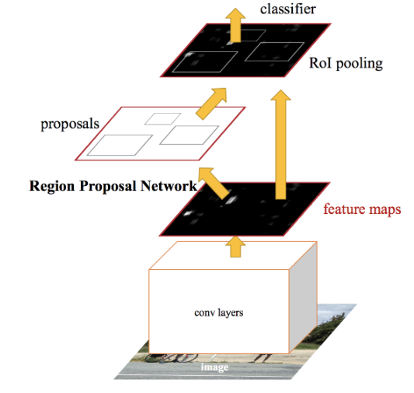
FASTER R-CNN
xx

Slide 30
FASTER r-CNN INCEPTION V2
It is a pre-trained detection model on the COCO(Common Objects in Context) dataset.
Typically it runs at a speed of 58ms per 600x600 image (including all pre and post-processing).
The detector performance on subset of the COCO validation set as measured by the dataset-specific mAP measures upto 28mAP.
Our object detection system is composed of two modules.
The first module is a deep fully convolutional network that proposes regions.
The second module is the Fast R-CNN detector that uses the proposed regions.

Slide 31
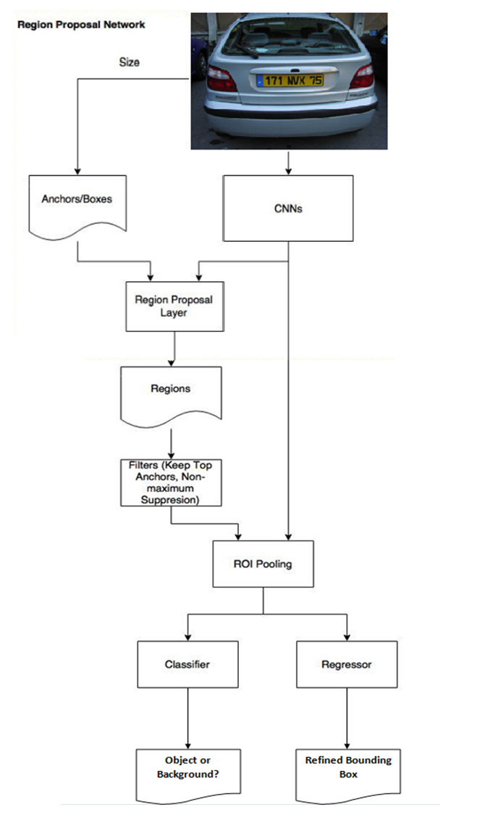

Slide 32
LP EXTRACTION
Procedure:
Get the tensor which stores the values of the detection boxes with the help of detection_graph function.
Get the values of Ymin, Ymax, Xmin, Xmax by manipulating the detection box array.
Get the values of width and height of the input image.
Extract the bounding box by using the tensorflow function.

Slide 33
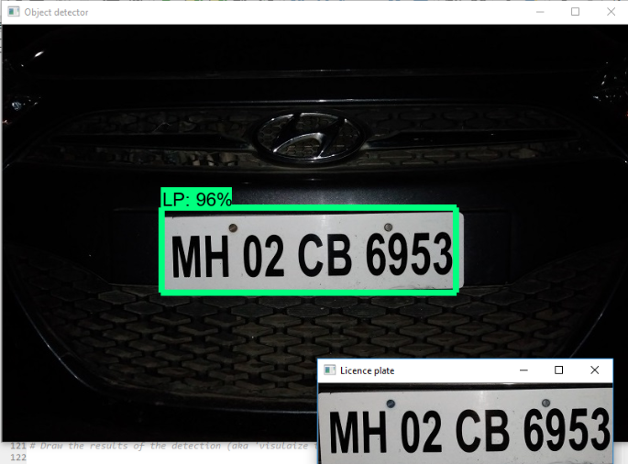
LP Extraction

Slide 34
Optical character recognition
OCR is the final step of the project.
We perform some pre-processing steps to the extracted image and then use the Tesseract library to perform OCR.
Pre-processing Steps Include:
Conversion from RGB to Grayscale
Otsu Binarization
Median Blur Filter
Python-tesseract is an optical character recognition (OCR) tool for python.

Slide 35

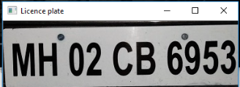


Slide 36
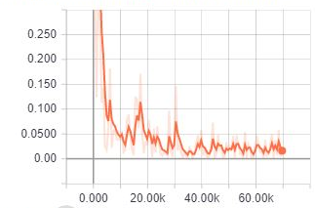
RESULTS
The trained model we obtained after training using 180 images is tested with 39 images, as the entire dataset of 219 is divided into 80% train images and approx. 20% test images, is bound to give an accuracy based on loss as described in the graph in Fig below.
Total loss vs Epochs

Slide 37
RESULTS
The calculated training and validation accuracy are:
Train Accuracy:: 0.9764634601043997
Test Accuracy :: 0.7933284397683713

Slide 38
APPLICATIONS
Parking Lot Management Systems
Toll Booth Management Systems
Traffic Control
Border Security
Law Enforcement

Slide 39
CONCLUSION
The faster R-CNN Inception model we used for this system not only provides very high accuracy for a small size of training data but it also has good generalization capability.
Optical character recognition performed with the Tesseract library works efficiently with some preprocessing on the extracted images of the LP.
LP detection works with high accuracy for real time images. However the OCR requires some pre-processing and can be further improved.

Slide 40
Thank You

